Slide 1

CIVIL AIR PATROL
WHY SQUADRON SENIOR MEMBERS ARE LEAVING CAP

Slide 2
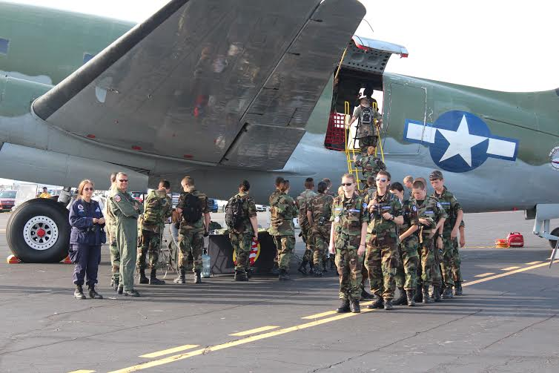
Reasons for CAP Members Turnover
A large number of members leave because their time and talents were not needed or valued for example those talented in artwork and those talented and interested in aviation.
Some members do not have enough time to commit to CAP because of work or other commitments for example commitment in other organizations and in their families.

Slide 3
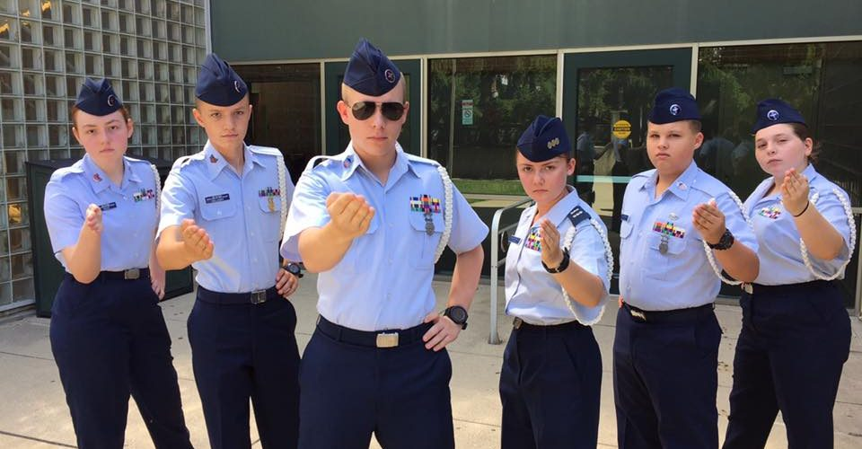
Professionalism
Consistent leadership
Consistent set of expectations
Prioritization of activities to benefit the organization and the service of the nation
Accountability

Slide 4
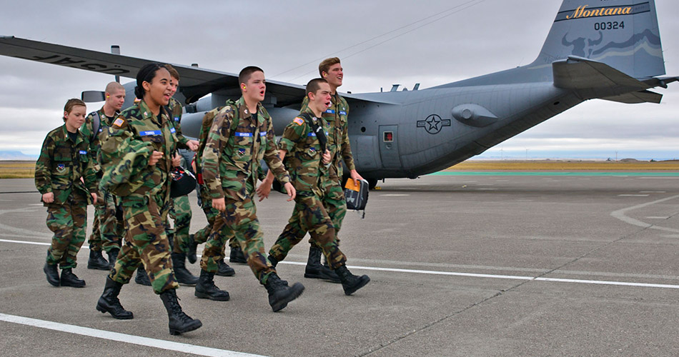
Involvement
Initiate and maintain engaging and productive activities.
Rolling out an apprenticeship and mentorship program in CAP for new recruits filling up the schedule of the senior members.
Getting the recruits into plane and not just physical training.
Diversify activities in the CAP camps.

Slide 5
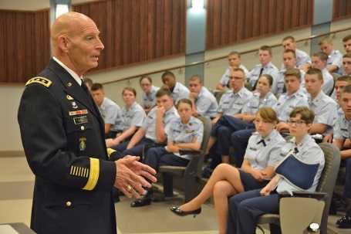
Communication
Get all stakeholders in the loop through periodic update of the status of events and affairs in CAP.
Ensure utility of social media for wide dissemination of relevant information.
Make communication as far in advance as possible to avoid miscommunication inconvenience

